Slide 1
Mint Medical Requirements
May 19, 2014

Slide 2
App Summary
Mint Medical is an iOS App that allow users to quickly find and book appointment with doctors, store prescription and send treatment requests.
There are a managing account for Doctor to view & manage his working schedules. And a control panel for Mint Medical Admin.
This App is similar to Open Medical App

Slide 3
S1: Introduction Screen
1. Slides right/left to see next/previous introduction slides
2. Click Done on last slide > Go to Home Screen (S2)
Introduction Slides
Introduction Slides
Next
Done

Slide 4
S2: Home Screen
1. Appointment
- This allow users to actively find and book appointment with registered Doctors
- Number of booked appointments are shown in small line under
- When tapped > Go to Appointment Screen (S4)
2. Treat me now
- Allow user to describe his issues and submit information to Mint Medical Admin
- When tapped > Go to Treat Me Now Screen (S5)
3. Prescription
- Show user’s prescriptions that he is following
- When tapped > Go to Prescription Screen (S6)
4. Locations
- Show location nearby user on List-view or Map-view
- When tapped > Go to Location Screen (S7)
5. Contact: When tapped > Go to Contact Screen (S8)
6. My Account: When tapped > Go to My Account Screen (S9)
7. About Mint Medical: When tapped > Go to About Screen (S10)
8. Login: When tapped > Go to Login Screen (S3).
- When user already logged in > Show Log Out. When tapped on Log-out > Go to Introduction Screen (S1)
Mint Medical
Login
Appointments
2 Upcoming
Treat Me Now
Request treatments
Prescription
1 active
Locations
Contact
Send email or call
My Account
Membership status
About Mint Medical

Slide 5
S3: Login Screen
Login by registered email and password
- After fulfill information & tap on Login > Go to Home Screen (S2) with “Log-out” word on Top right
2) Click Register (for user who not yet have account)
- When tapped > Go to Server Register site (Se1)
3) Tap on Forget password > Go to Server Forget password site (Se2)
4) Click cancel to come back Home Screen (S2) with “Log-in” word on Top right
LOGO
Email: …………………………………..
Password: ……………………………
Login
Forget password
Not yet a member
Register
Cancel

Slide 6
S4: Appointment Screen
1. Back
- When tapped > Go back to Home Screen (S2)
2. New
- When tapped > Go to S4-A (To start making appointment)
3. New Appointment
- In 1st time login, it says “you have no upcoming appointments” > start making appointment by tap on “New appointment” > Go to S4-A
- After 1st appointment booked, this icon disappeared, and be replaced by list of Upcoming Appointment (As shown on S4-I)
4. Appointment History
- In 1st time login, it says “You have no history appointments. Please start your first one by tap on “New Appointment” above”
- When user made his appointment, the appointment history list will be shown on S4-I
Back
Appointment
New
You have no upcoming appointments
New Appointment
Appointment History
You have no history appointments. Please start your first one by tap on “New Appointment” above

Slide 7
S4: Appointment Screen
(Pictures shown in next slides)
1. At S4-A: User can choose appointment types.
1.1. When tap on “My primary care team” > Go to Visit type S4-B Screen > When choose any Visit type > Go to Reason screen S4-C Screen > After writing reason & tap “Next” > Go to Availability screen S4-D > Choose an appointment > Go to Details screen S4-E > Tap “Book Appointment” > Go to Se you soon screen S4-F
1.2. When tap on “A specific office” > Go to S4-B > Show a list of Office as S4-G screen > Choose an office > Go to S4-C > After writing reason & tap “Next” > Go to Availability screen S4-D with only available times of doctors at this office only (*)> Choose an appointment > Go to Details screen S4-E > Tap “Book Appointment” > Go to Se you soon screen S4-F
1.3. When tap on “A specific doctor” > Show a list of Doctor as S4-H > Choose a Doctor > Go to Visit type S4-B Screen > When choose any Visit type > Go to Reason screen S4-C Screen > After writing reason & tap “Next” > Go to Availability screen S4-D with only available time of that Doctor only > Choose an appointment > Go to Details screen S4-E > Tap “Book Appointment” > Go to Se you soon screen S4-F
Note:
(*) There can be more than 1 doctor at 1 office

Slide 8
S4-A
S4-B
S4-C
Appointment
Cancel
Visit Type
Cancel
Reason
Cancel
Back
Back
I want to see availability for…
I want to be seen for…
I would like to cover…
My primary care team
Non selected
Brief visit
E.g. Cold/flu, sinus infection, joint sprain
Tell us the reason for your visit
A Specific Office
Standard visit
E.g. Abnormal pain, chest pain
Next
A specific doctor
Physical exam
A comprehensive health evaluation
Appointment type
- This screen show 3 type of Appointments
- Tap on Cancel > Go to Appointment screen (S4)
Visit Type
- This screen show 3 types of visit
*Brief = short visit
*Standard visit and
*Physical visit
- Tap on Cancel > Go to Appointment screen (S4). & Back to previous screen
Reason
- This screen allow user to describe a short explanation of his issue
- Tap on Cancel > Go to Appointment screen (S4)
- Tap “Next” icon > Go to Availability screen (S4-D). & Back to previous screen

Slide 9
S4-D
S4-E
S4-F
Back
Availability
Cancel
Back
Details
Cancel
See you soon
Done
Monday. May 19, 2014
Doctor
Picture
Monday. May 19, 2014 @10:00 SG
Doctor Name, Doctor Level
Office Address
10:00 SG
Doctor Name, Doctor Level
Office Address
0.7km
11:00 SG
Doctor Name, Doctor Level
Office Address
Your Appointment is booked!
Visit type
Reason for this visit
Please arrive 5 minutes before your appointment to allow for check-in.
Should you need to cancel, please do so at least 24 hrs in advance.
1.1km
Tuesday. May 20, 2014
Location Map-view
09:15 SG
Doctor Name, Doctor Level
Office Address
5.3km
11:30 SG
Doctor Name, Doctor Level
Office Address
5.5km
Book Appointment
13:55 SG
Doctor Name, Doctor Level
Office Address
8.5km
Availability
- This screen show available time of doctors listed by Days coming
- Information include: Time, Doctor name & level, Address, & Distance
- Tap on Cancel > Go to Appointment screen (S4). & Back to previous screen
Details
- This screen show
*Doctor image & information
*Option details chosen from Availability screen + Reason
*Location on Map-view
- Tap on Cancel > Go to Appointment screen (S4). & Back to previous screen
See you soon
- This screen is a confirmation after booking.
- Tap on Done > Go to Appointment Screen with added appointments (S4-G)

Slide 10
S4-G
S4-H
S4-I
Back
Select Office
Cancel
Back
Select Doctor
Cancel
Back
Appointment
New
Office Name
Office Address
Search for Doctor Name
2 upcoming appointments
0.7km
A
B
C
D
E
F
G
H
I
K
L
M
N
…
Monday. May 19, 2014 @10:00 SG
Doctor Name, Doctor Level
Office Address
Doctor
Picture
Doctor Name, Doctor Level
Office Address
Office Name
Office Address
1.7km
Monday. May 19, 2014 @10:00 SG
Doctor Name, Doctor Level
Office Address
Office Name
Office Address
Doctor
Picture
Doctor Name, Doctor Level
Office Address
2.7km
Appointment History
Monday. May 19, 2014 @10:00 SG
Doctor Name, Doctor Level
Office Address
Appointment Status
Office Name
Office Address
3.7km
Doctor
Picture
Doctor Name, Doctor Level
Office Address
Office Name
Office Address
Sunday. May 18, 2014 @17:05 SG
Doctor Name, Doctor Level
Office Address
Appointment Status
4.7km
Select Office
- show list of office + address + distances (list from near to far)
- Tap on Cancel > Go to Appointment screen (S4). & Back to previous screen
Select Doctor
- Show Doctor list with names + Picture + address listed by Name as contact list
- Search Tool allow user to search as contact list
- Tap on Cancel > Go to Appointment screen (S4). & Back to previous screen
Appointment screen
- This is how it look like after having appointments booked.

Slide 11
S5: Treat Me Now Screen
This screen allow user to describe a short explanation of his issue
Tap on Cancel > Go to Home screen (S2)
Tap “Send request” icon > Go to S4-F with word change to “Your request is sent! Our team will contact you soon to help you.”
=> Then this request will sent to Control panel of Mint Medical Admin for further action
New case
Cancel
I think I have…
Tell us more detail of your issue and we will contact you very soon
Send request

Slide 12
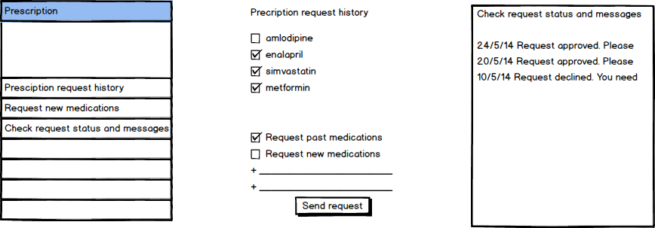
S6: Prescription Screen
1. Prescription Request Status
+ View history request
+ Status of request
2. View prescription detail, from Doctor send & Admin Mint Medical send
3. Request new Prescription
+ Write in box
+ Send to Admin

Slide 13
S7: Locations Screen
There are 2 options to view
1. Click on List = View on list (The list be shown is the same with list on S4-G)
* There are a background under “List” icon
2. Click on Map = View on map with the center point is Current location & office surrounding if they are close enough
* There are a background under “Map’’ icon
3. When tap a location (Office) > Go to S7-A Screen
Back
List Map
Back
List Map
Office Name
Office Address
Map-view
0.7km
Office Name
Office Address
1.7km
Office Name
Office Address
2.7km
Office Name
Office Address
3.7km
Office Name
Office Address
4.7km

Slide 14
S7-A
1. Icon back > Go to Location screen (S7)
2. Map-view = appearance of office location of map
3. Office name & address is shown
4. Book an appointment: Tapped > Go to S4-B > S4-C > After writing reason & tap “Next” > Go to Availability screen S4-D with only available time of doctors on that office only > Choose an appointment > Go to Details screen S4-E > Tap “Book Appointment” > Go to Se you soon screen S4-F
5. Call this office: Tapped > Pop-up Phone app with Call action right away happen (user call to office)
6. Driving direction: Tapped > Show direction from current location to this location
Back
Office
Location Map-view
Office Name
Office Address
Book an appointment
Call this office
Driving direction

Slide 15
S8: Contact Us Screen
Back
Contact
1. My doctor
- When user not yet buy membership > Can not see
- When user bought membership > Appear for usage
2. One medical support: Tapped > Open Mail App with
+ Mail title = Support
+ To = admin@mintmedical.sg / admin@ilokun.com (client’s confirmation)
3. Feedback: Tapped > Open Mail App with
+ Mail title = Feebback
+ To = feedback@mintmedical.sg / feedback@ilokun.com (client’s confirmation)
4. Share: Tapped > Open Mail App with
+ Mail title = Mint Medical Service – Register yours
+ From = client’s email address
+ Content = (client’s confirmation)
My doctor
Active membership required
One medical support
Billing, general questions
Feedback
Tell us how you are doing
Share
Refer a friend to Mint Medical

Slide 16
S9: Account Screen
Back
Account
1. User's information when registered appear here
+ Picture
+ Name + Joining year
+ Email address & Contact
2. Click on update my account > Go to Web view to update & make payment if user want to
User image (not available)
User Name
Member since 2014
Doctor
Non selected
Email address
Tuyen.dao@gmail.com
Update my account

Slide 17
S10: About Mint Medical Screen
1. Content to be provided by client
2. What we offer: Tapped > Go to detail screen. Content to be provided by client
3. Location: Tapped > Go to Location screen (S7)
Back
About
Back
What we offer
Picture
Picture
Mint medical is…
To be provided by client
What we offer…
Content to be provided by client
What we offer
Locations

Slide 18
Server Summary
Which Functions are needed?
1. For Doctor
+ Timetable manage: Input (available/unavailable time), edit
+ Timetable view
+ Prescription panel: Add, edit
2. For Mint Medical Admin
+ Office & Doctor information manage: Add, Edit
+ Panel for Receiving & showing Feedback, Request of Treat me now, contact from users
3. Appointment
+ Book/Cancel
+ Time: Available/Not-available
4. Account register/Login site
+ Allow edit & upgrade later for payment (E.g.)
5. Payment
Which APIs are needed?
1. Office
+ Location: Longitude & Latitude
+ Address
+ Phone number
+ 1 office can have many doctors
2. Doctor
+ Name, Level
+ Picture
+ Address
3. User
+ Personal information: Email/Contact/Name/Address
4. Appointment
+ Date
+ Time: Available/Not-available
5. Payment
+ Card information

Slide 19
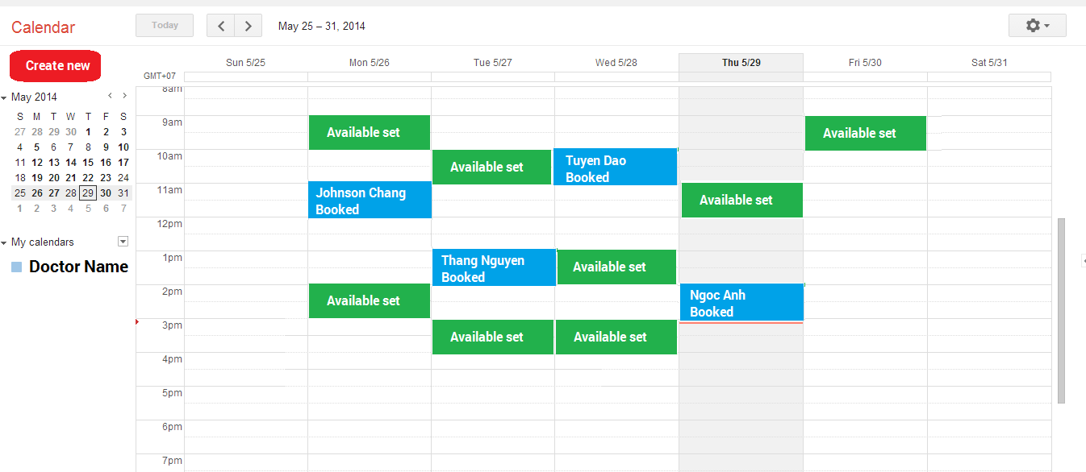
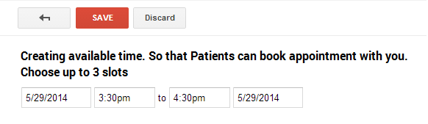
Click on CREATE NEW => Go to this screen
Ser1: Doctor time manage

Slide 20
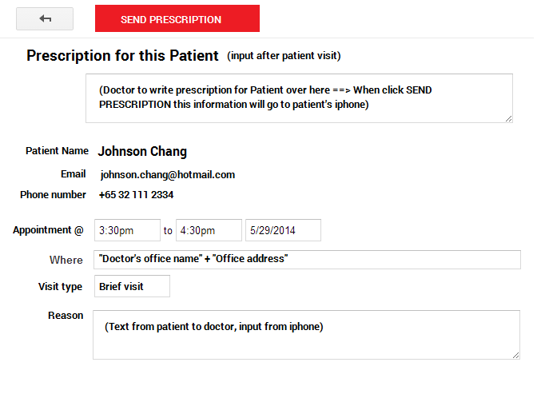
1. Click on each appointment booked => Go to this screen 2. Patient’s information appear hear 3. After visit, doctor can input Prescription here and send to user by clicking SEND PRESCRIPTION
Ser2: Doctor appointment + Prescription

Slide 21
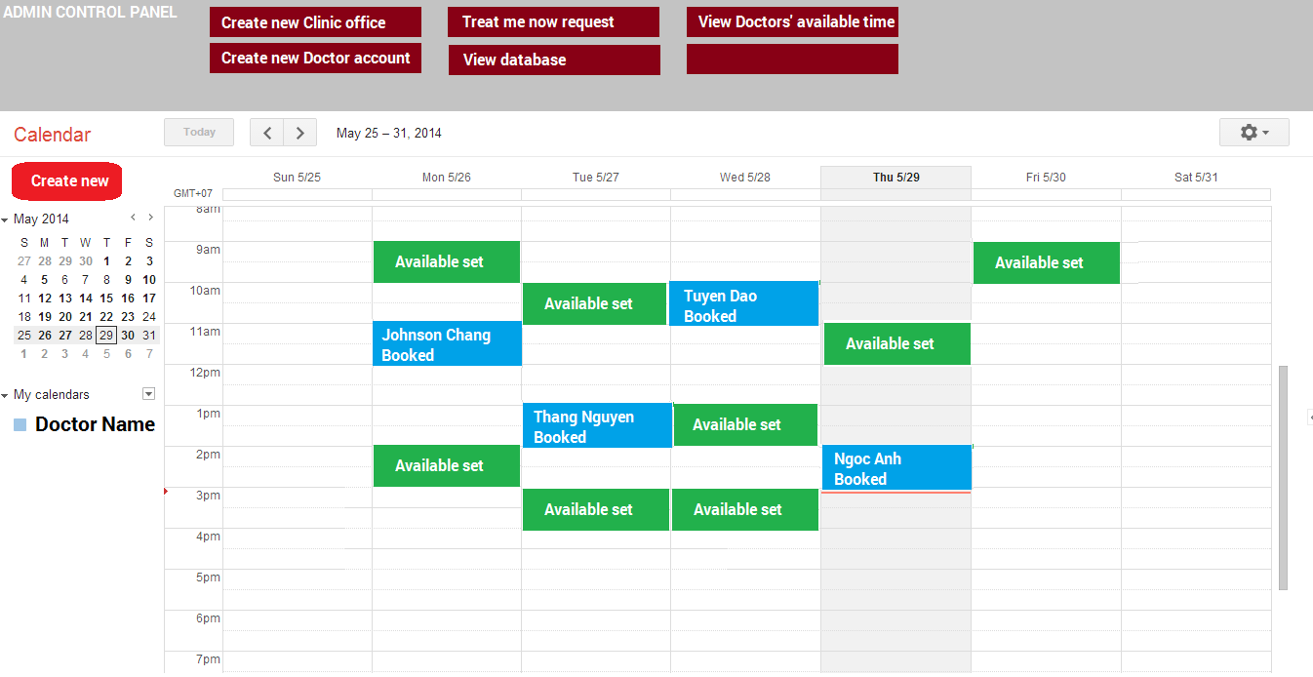
Ser3: Admin control panel

Slide 22
Doctor Control Panel Flow
1. Create available time for patient booking
+ Date & Time
2. View appointment detail from Patient
+ Patient’s information
+ Type of visit
+ Reason
3. Input prescription for Patient & send
+ Input text and send
Admin Control Panel Flow
1. Create clinic location
+ Name of office/clinic location
+ Address + Zip-code
+ Contact
+ Longitude, Latitude
2. Create Doctor profile
+ Name
+ Doctor level/Professional
+ Contact/phone no
+ At name of office/clinic location
+ Picture
3. Treat me now request
+ View list of request sent to server
+ Name, patient ID
+ Prescription detail
+ Time of request
4. Doctor available view
+ View list
+ Search for name
+ View doctor time management

